Slide 1
Car Project
My Car Project

Slide 2
Abstract
This Project is like Car and here we will implement 8 functionalities like
Sign Up
Create profile
Sign In
View Profile
Sign-in
View All Profile
Delete Profile
Search Profile
Edit Profile
Sorting Profile

Slide 3


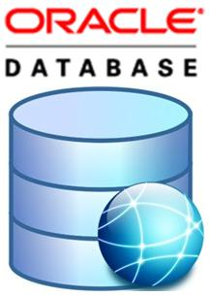
Software Requirements
Java 1.8 version
Eclipse
Oracle

Slide 4
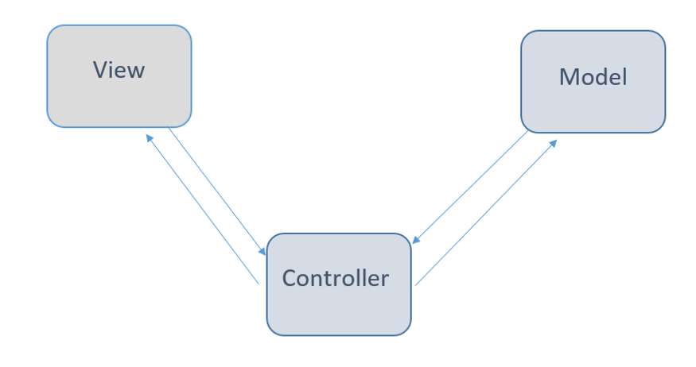
Design Phase
Project is designed using MVC(Model View Control) Architecture.
It has three main components:
Model
View
Controller

Slide 5
Model:
It is known as the lowest level ( it is responsible for maintaining data). Adding or retrieving data is done in the model component. It responds to the controller requests because the controller never talks to the database by itself.
Note: the model never communicated with the view directly.
View:
Data representation is done by the view component. It actually generates UI or user interface for the user. So at web applications when you think of the view component just think the Html/CSS part. Views are created by the data which is collected by the model component but these data aren’t taken directly but through the controller, so the view only speaks to the controller.
Controller:
It’s known as the main man because the controller is the component that enables the interconnection between the views and the model so it acts as an intermediary. The controller doesn’t have to worry about handling data logic, it just tells the model what to do. After receiving data from the model it processes it and then it takes all that information it sends it to the view and explains how to represent to the user.

Slide 6
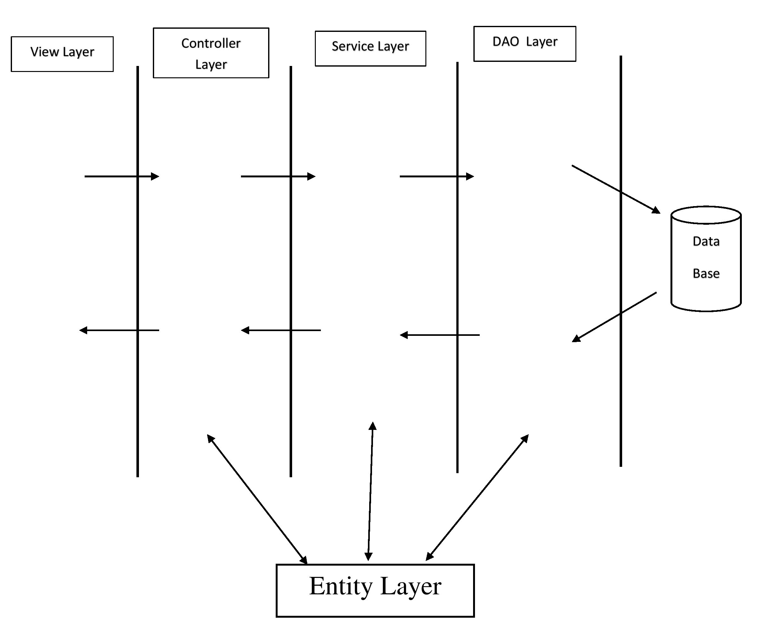
Layers in project

Slide 7
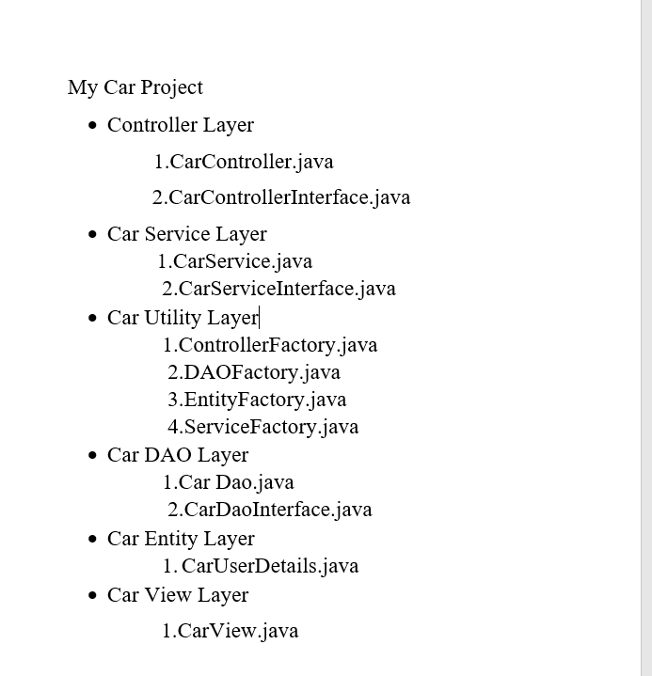
Project Structure

Slide 8
Layers and their methods
View Layer | Controller Layer | Service Layer | DAO Layer
SignUp() SignIn() viewAllProfile() viewProfile() deleteProfile() editProfile() sortingProfile() searchProfile() | viewAllProfile() viewProfile() deleteProfile() editProfile() searchProfile() signUp() signIn() | viewAllProfile() viewProfile() deleteProfile() editprofile() sortProfile() searchProfile() signUp() | viewAllProfile() viewProfile() deleteProfile() editprofile() sortProfile() searchProfile() signUp()

Slide 9
Factory Design Pattern
A Factory Pattern or Factory Method Pattern says that just define an interface or abstract class for creating an object but let the subclasses decide which class to instantiate. In other words, subclasses are responsible to create the instance of the class.
To achieve low coupling.
In project we 4 factory files
Controller Factory
Service Factory
DAO Factory
Entity Factory
These files returns object for their respective classes.

Slide 10
Data Base Design
In this I created tables in a data base namely,
User
Columns in userdetails table:
- name
Email
Phone number
Address

Slide 11
Testing Phase
In this project I performed unit testing using junit4 in maven project.
Created 3 test files for 3 layers namely
Controllerlayer
Servicelayer
Daolayer

Slide 12
Conclusion
This is foundation project to get familiar on java, eclipse ide, oracle and it is used to user to register their details and can perform all functionalities in the project if the user data is existed in the userdetails database.

Slide 13
Future Scope
To add UI for this project using HTML,CSS and JAVASCRIPT.

Slide 14
Thank you!

